Slide 1
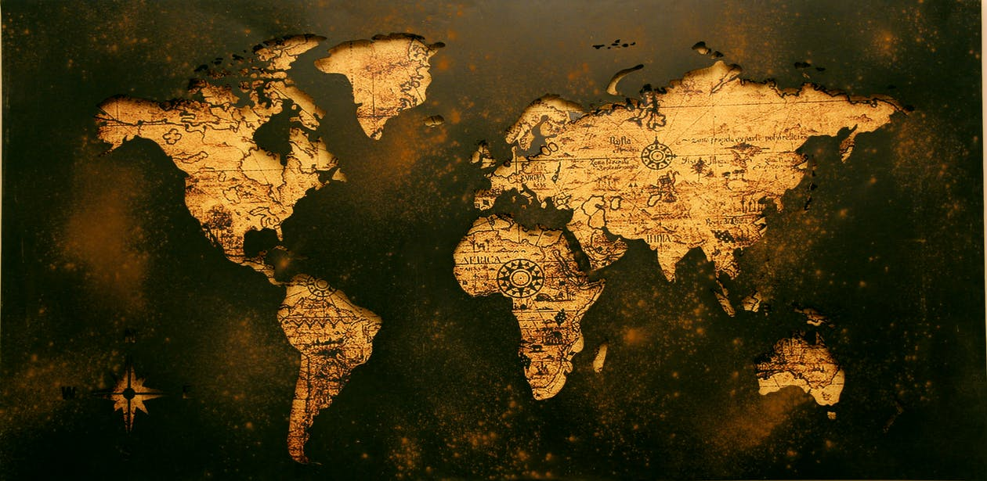
GEOGRAPHY
Google Maps and Google Earth

Slide 2
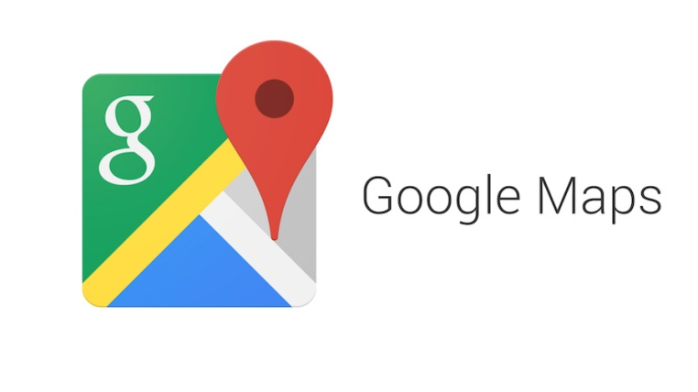
A map can give us a lot of information about a place, let's find out what we can do with

Slide 3
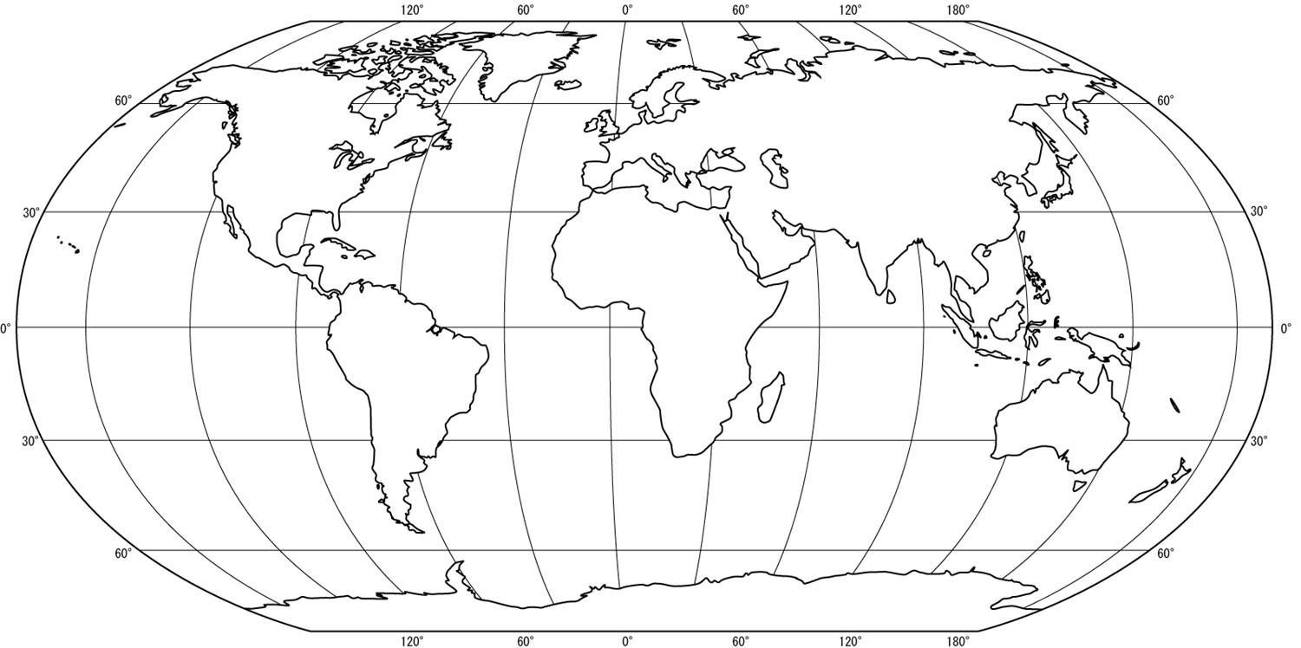
…but first, we are going to highlight some key concepts:
MAP
Notes:
Map → A drawing on a flat surface, of parts or features of a place, as of the earth.

Slide 4
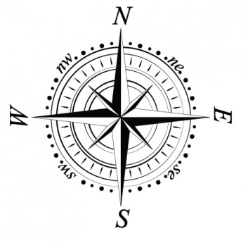
…but first, we are going to highlight some key concepts:
CARDINAL POINTS
MAP
CONTINENT
Notes:
Cardinal point → One of the four main points of the compass: north, south, east, and west
Continent → One of the seven large land masses on the earth's surface, surrounded, or mainly surrounded, by sea and usually consisting of various countries.

Slide 5
…but first, we are going to highlight some key concepts:
CARDINAL POINTS
MAP
CONTINENT
LATITUDE
LONGITUDE
Notes:
Latitude → the position north or south of the Equator measured in degrees.
Longitude → the distance of a place east or west of the Greenwich meridian, measured in degrees.

Slide 6
…but first, we are going to highlight some key concepts:
CARDINAL POINTS
Greenwich Meridian
MAP
CONTINENT
LATITUDE
EQUATOR
LONGITUDE
Notes:
Equator → an imaginary line drawn around the middle of the earth an equal distance from the North Pole and the South Pole.
Meridian → one of the lines that is drawn from the North Pole to the South Pole on a map of the world

Slide 7
…but first, we are going to highlight some key concepts:
CARDINAL POINTS
Greenwich Meridian
MAP
CONTINENT
Tropic of Cancer
LATITUDE
EQUATOR
Tropic of Capricorn
LONGITUDE
Notes:
Tropics → the area between the two tropics (Tropic of Cancer and Tropic of Capricorn), which is the hottest part of the world.

Slide 8
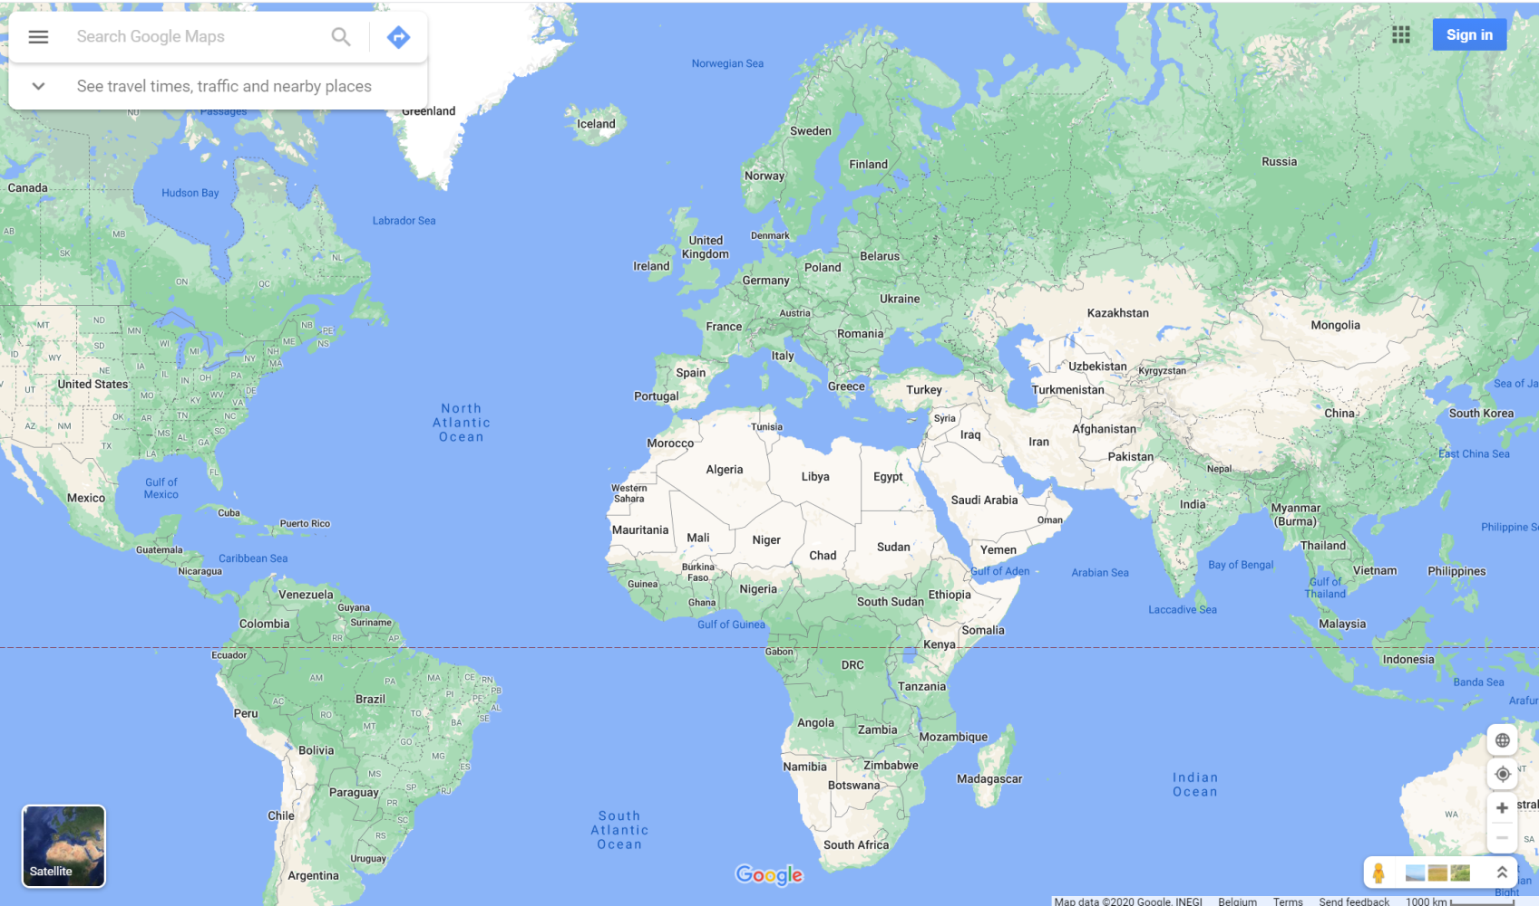
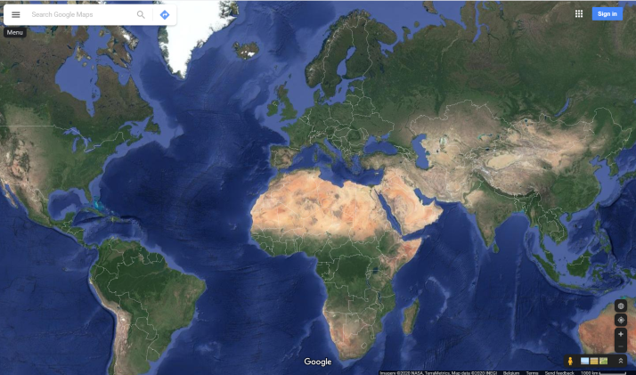
Search a place
click on the satellite view

Slide 9
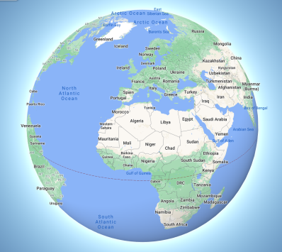
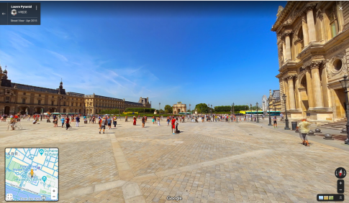
Search a place
Click here to see the globe
click on the satellite view
Street View Images

Slide 10
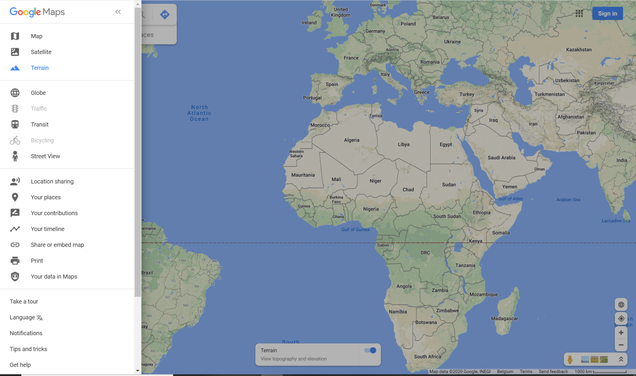
By clicking on ‘terrain’ you can get an idea of the topography and elevation of places.

Slide 11
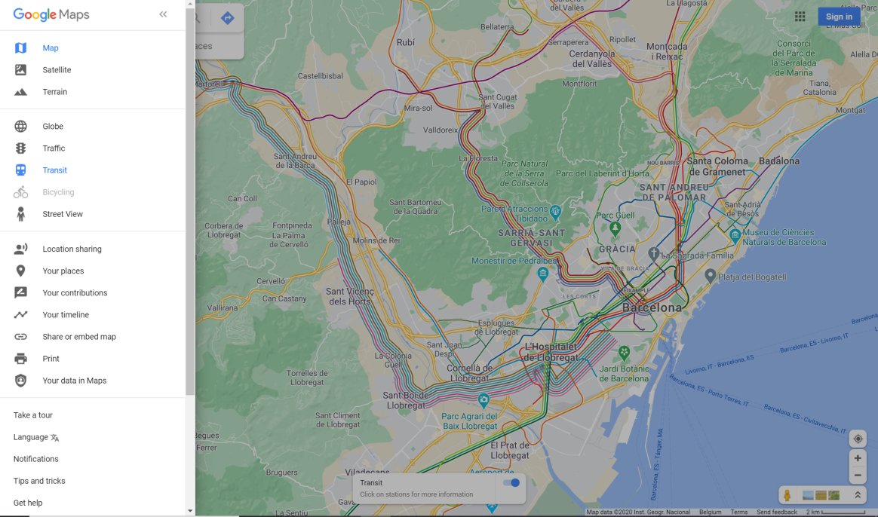
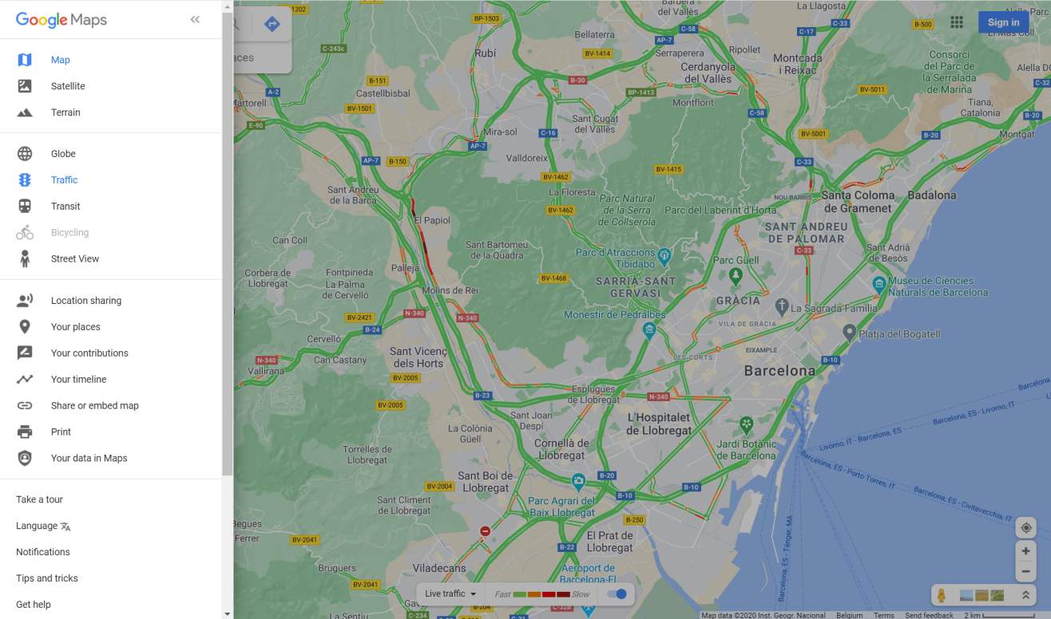
By clicking on ‘traffic’ you can know the live traffic on roads e.g. Barcelona (see the image)
By clicking on ‘transit’ you can know the public transport of an area e.g. Barcelona (see the image)

Slide 12
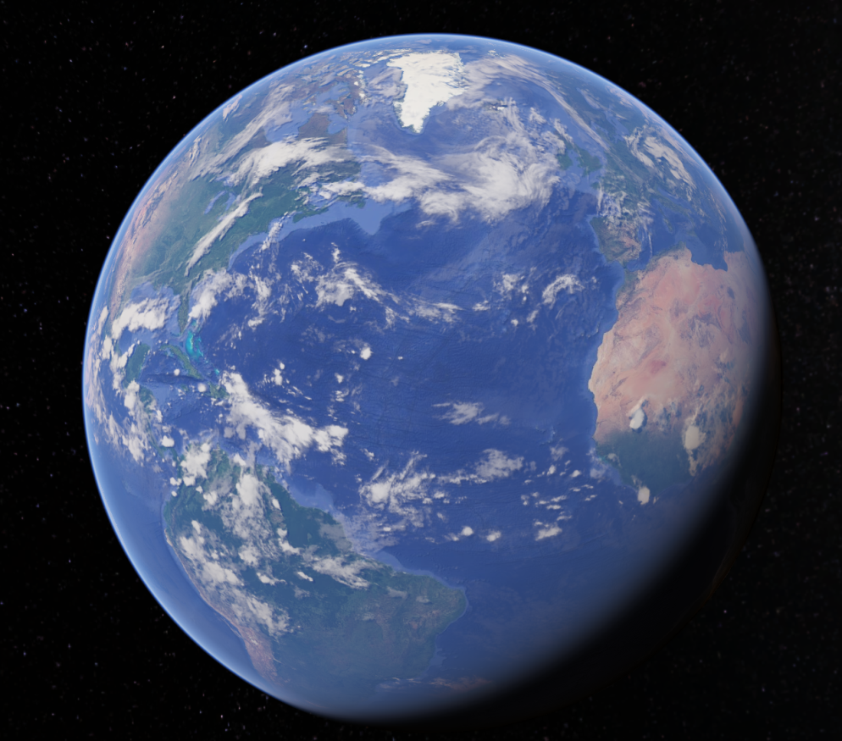
Menu
Search
Voyager
I’m Feeling Lucky
Projects
Map Style
Measure distance and
area

Slide 13
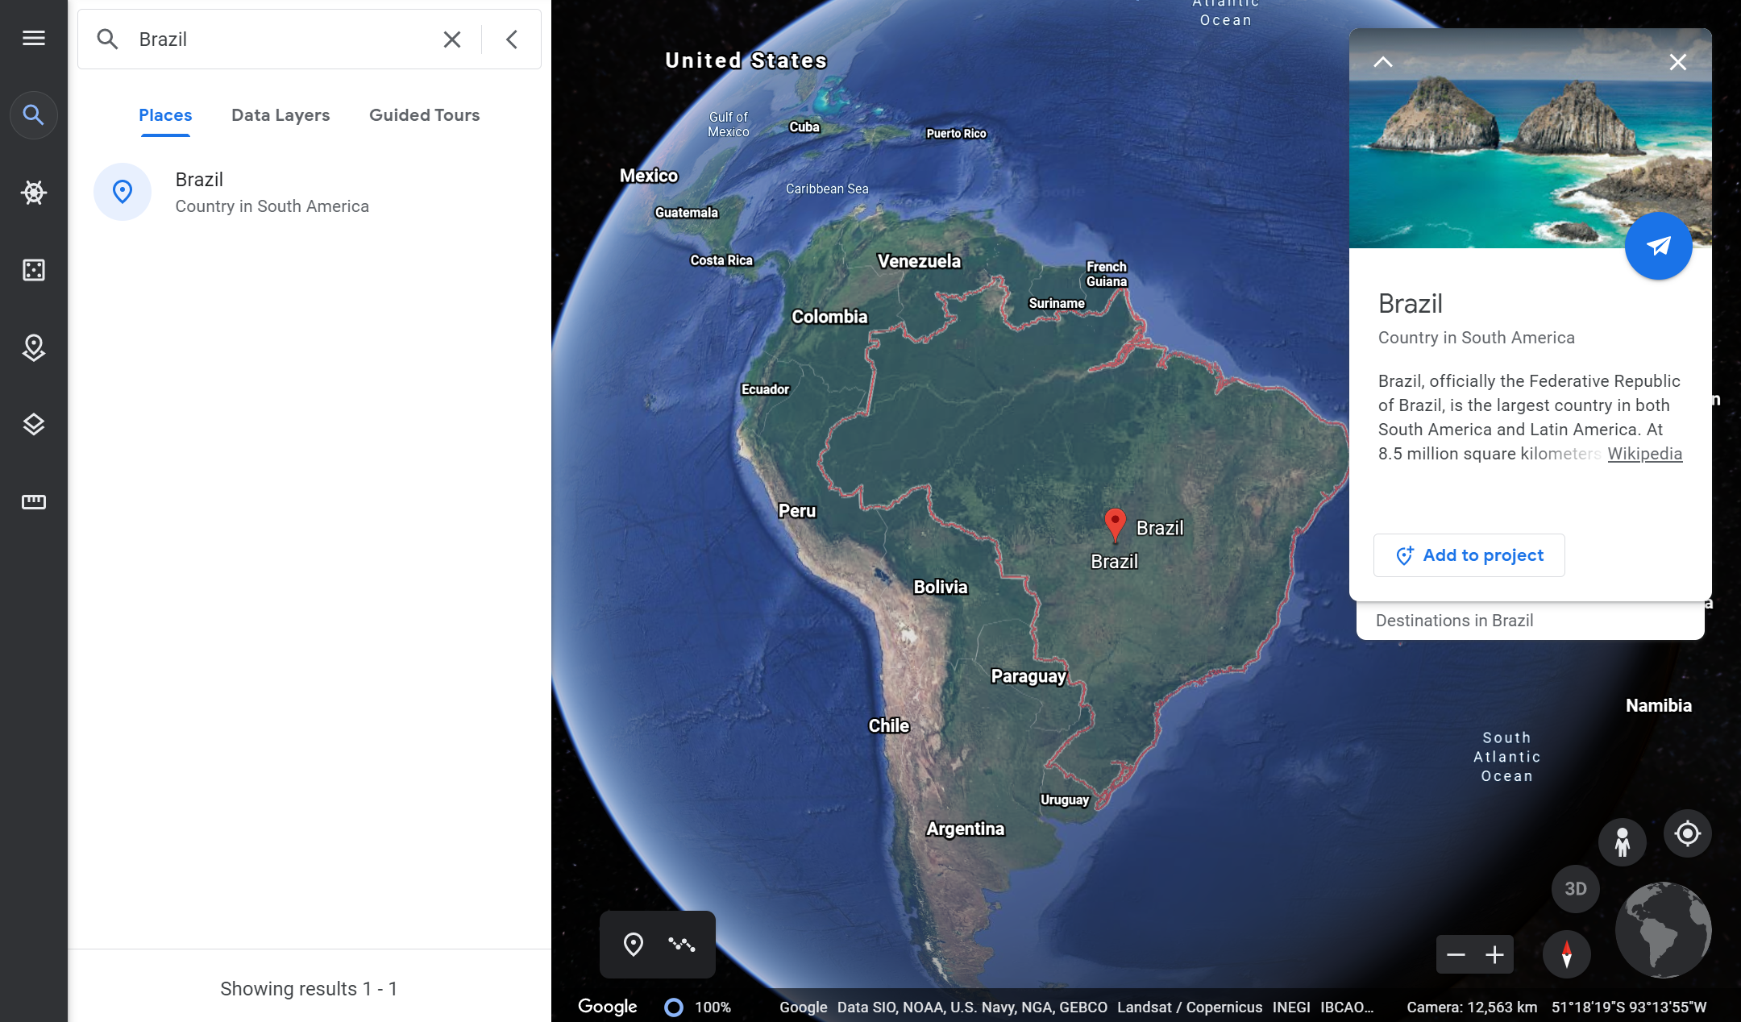
Search a place and get information about it.

Slide 14
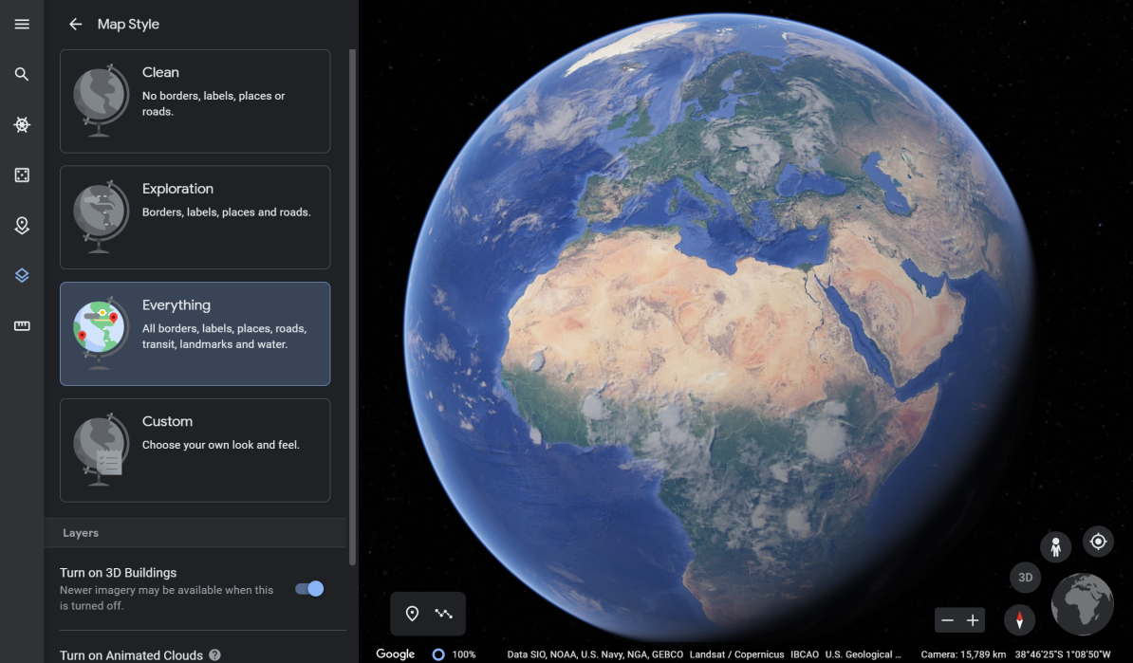
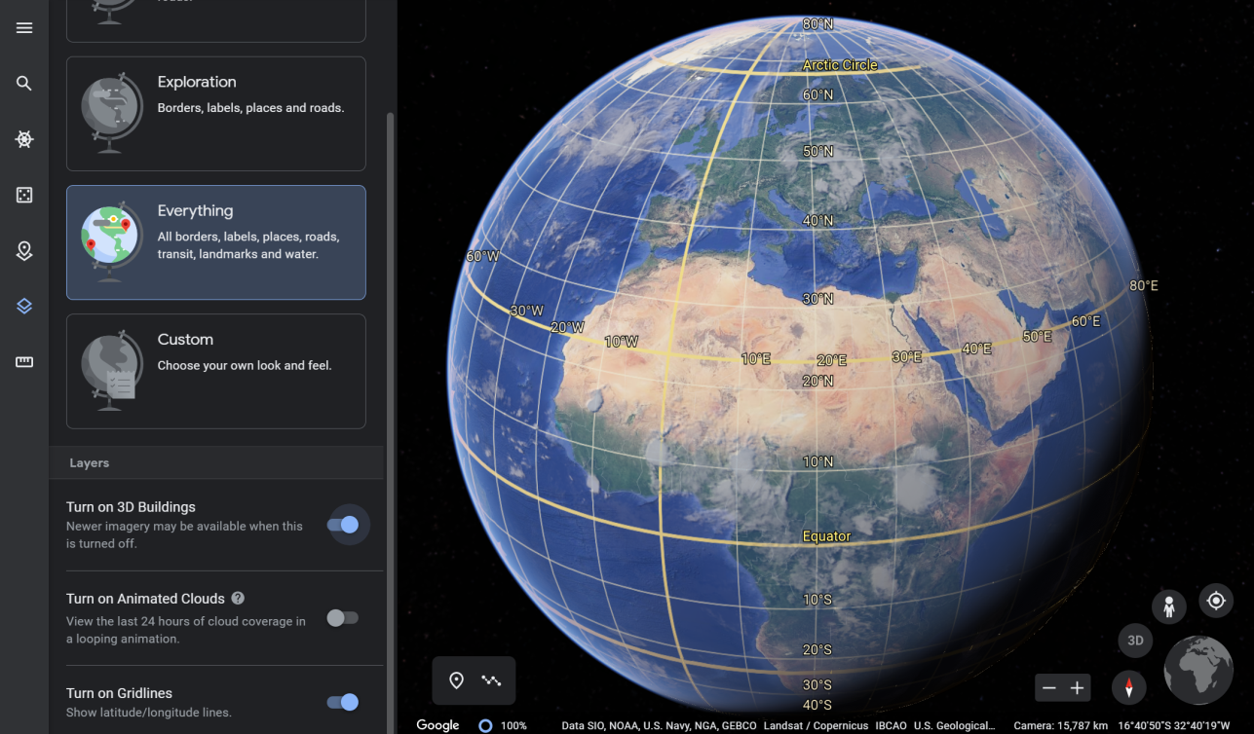
By clicking here you can choose the map style. There are 4 options (clean, exploration, everything, custom).
See all gridlines (equator, meridian, tropics…)

Slide 15
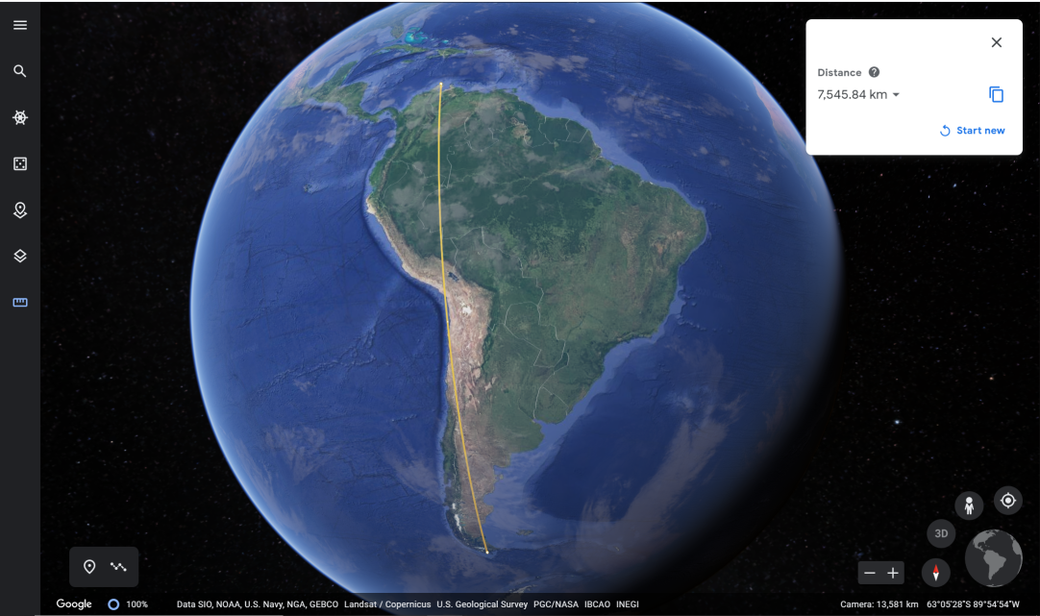
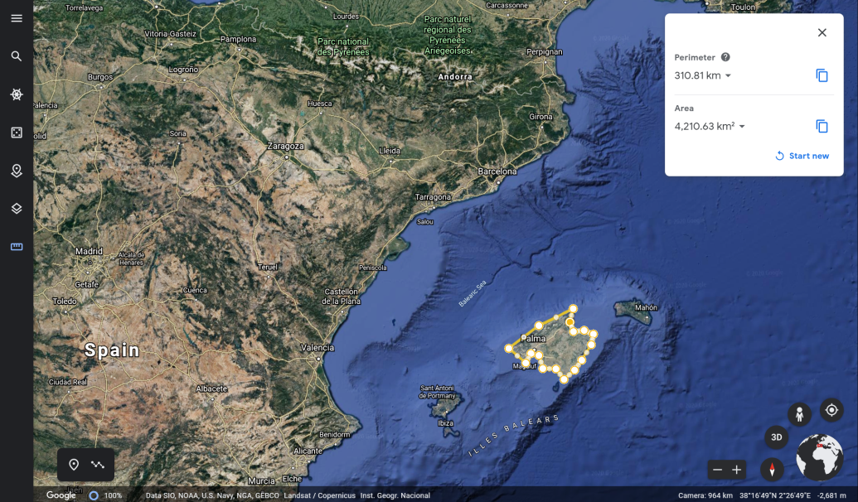
Also, you can draw a shape to know perimeters and areas. e.g. Mallorca (Island of Spain)
By clicking here and drawing a line you can know the distance of a place.

Slide 16
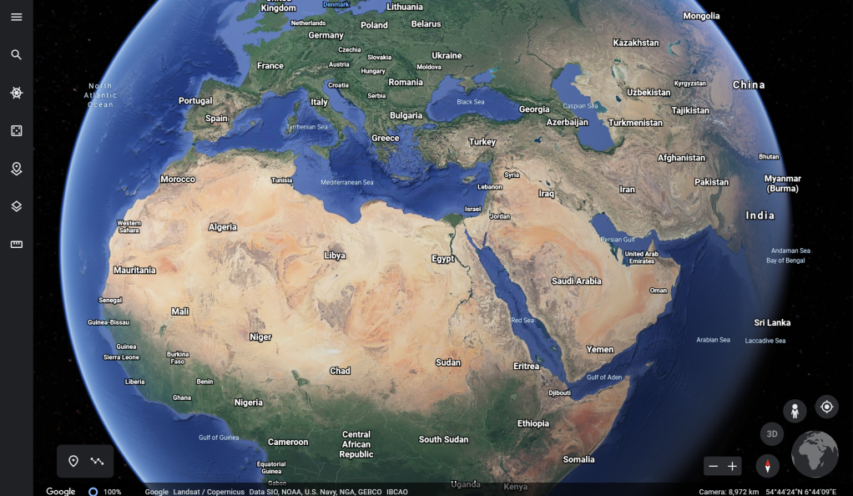
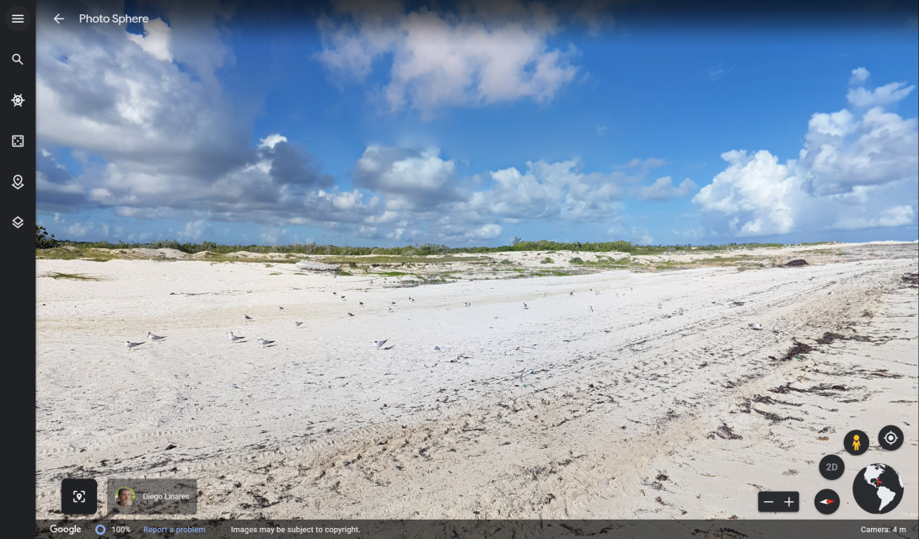
Information of the location in a small world map.
Street View Images

Slide 17
This has been the basis of how to use Google Maps and Google Earth. Now explore yourself!

